Slide 1
Informed search

Slide 2
Recap: Uninformed search algorithms
Classic search algorithms search only based on information that has already been provided by the problem.
These algorithms will traverse the whole search tree until they hit a solution, or else exhaust the graph. These are also called uninformed search algorithms or blind search algorithms.
Uninformed search algorithms become unreliable or even intractable when the problem is more complex.

Slide 3
Informed (Heuristic) search algorithms
Heuristic search algorithms can use the knowledge beyond the problem definition itself to try paths by order of ‘promise,’ so to find solutions efficiently.
To get this extra information, heuristic search algorithms use a heuristic function h(n).
Heuristic search algorithms also employ an evaluation function to help decide which nodes to explore first.
Heuristic search algorithms also employ an evaluation function to help decide which nodes to explore first.
Usually heuristic search algorithms will explore nodes in ascending order of associated value of evaluation function.
The algorithms vary primarily across the choice of evaluation function.

Slide 4
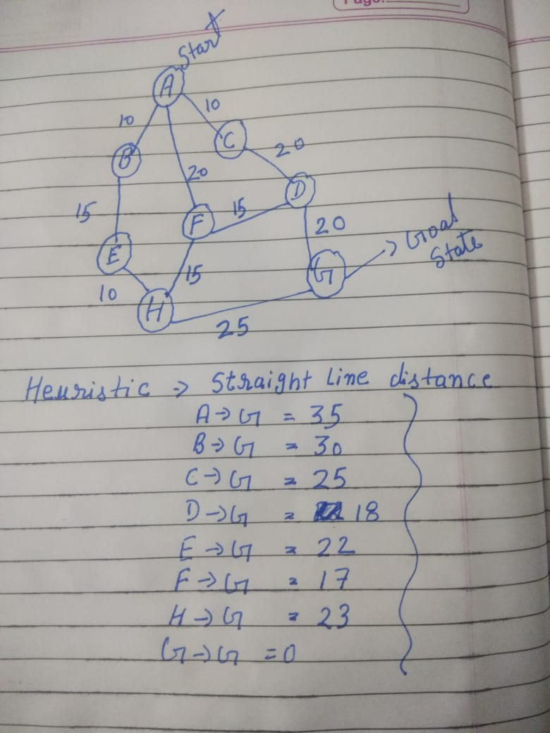
Greedy best-first search

Slide 5
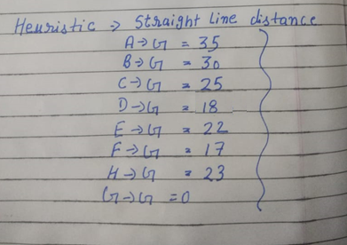
Greedy best-first search

Slide 6
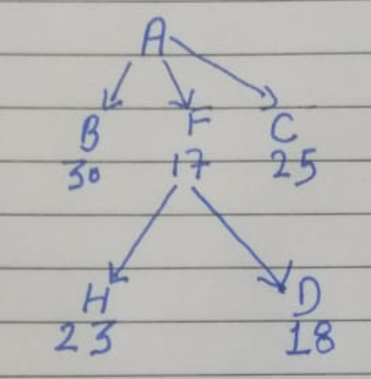
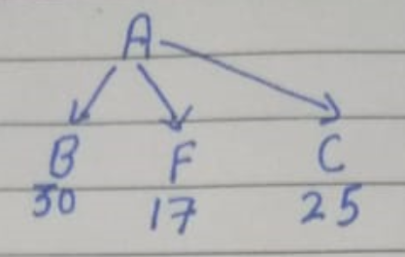
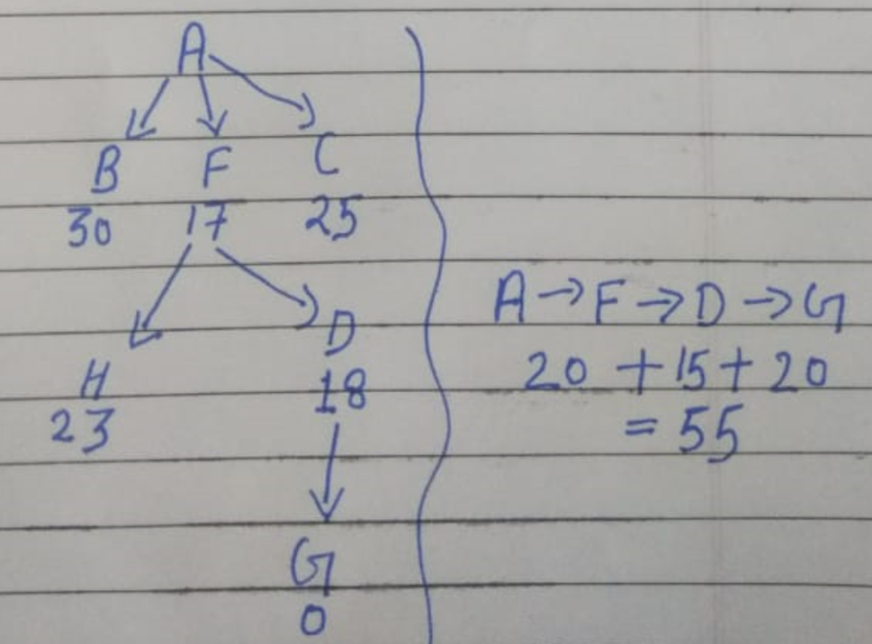
Greedy best-first search

Slide 7
The worst-case time and space complexity is O(b^{m})
Where m is the maximum depth of the search space.
With a good heuristic function, however, the complexity can be reduced substantially.
The amount of the reduction depends on the particular problem and on the quality of the heuristic.

Slide 8
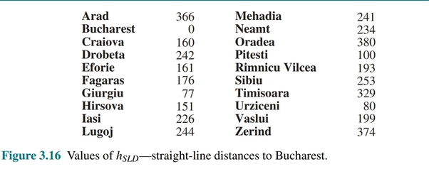

Slide 9
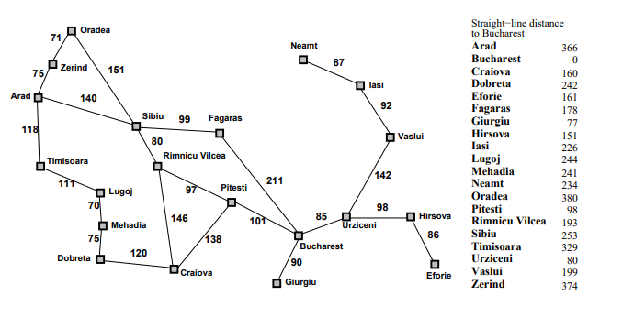

Slide 10
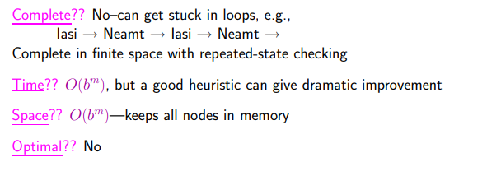
Properties of Greedy Best Search

